Slide 1
优邻购 Eyulingo
第三组 高鹏成 于喜千 何思泽 高鸿博

Slide 2
目录
关于产品
设计
技术
特色
经验教训

Slide 3
1. 关于产品
****************************************

Slide 4
产品背景
O2O零售行业快速崛起
拓展业务和提高利润的需要
茅台酒厂目前的销售方式落后
快速抢占市场份额

Slide 5



目标用户
管理员
消费者
经销商

Slide 6
产品简介
管理员
消费者
经销商

Slide 7
2. 设计
****************************************

Slide 8
3. 技术
****************************************

Slide 9
4. 特色
****************************************

Slide 10
5. 经验教训
****************************************

Slide 11
“
“A person who never made a mistake never tried anything new.”

Slide 12
Your slide title
Write here a list of features
Here you can write more
More about your project.
Content itself is what the end-user derives value from also can refer.

Slide 13
Big Title
The marketing mix is a business tool used in marketing and by marketers.

Slide 14
Content in two columns
Content A
Content B
Content itself is what the end-user derives value from also can refer to the information provided through the medium, the way in which
Content itself is what the end-user derives value from also can refer to the information provided through the medium, the way in which

Slide 15
Content in three columns
Content A
Content B
Content C
Content itself is what the end-user derives value from also can refer to the information provided through the medium,
Content itself is what the end-user derives value from also can refer to the information provided through the medium,
Content itself is what the end-user derives value from also can refer to the information provided through the medium,

Slide 16

A Picture Is Worth A
Thousand Words
Itself is what the end-user derives value from also.

Slide 17

Use Big Images To Show Your Ideas

Slide 18
Features with icons
Service 01
Service 02
Service 03

Slide 19
Tables to compare data
 | A | B | C
Content A | 100 | 200 | 400
Content B | $67,000 | $56,000 | $78,000
Content C | 4500 | 60000 | $8,000

Slide 20
World Map
Europe
19,450000
USA
19,450000
Brasil
19,450000

Slide 21
56,790,500
Write here your big numbers

Slide 22
56,790,500
130%
56,790,500
Revenue from sales
Project Achievements
Users around the world

Slide 23
The Process
Step 02
Step 04
Due to the fact that mobile
Due to the fact that mobile
Step 01
Step 03
Step 05
Due to the fact that mobile
Due to the fact that mobile
Due to the fact that mobile

Slide 24
Shapes to explain ideas
YOUR TITLE
YOUR TITLE
YOUR TITLE
Write your description here
Write your description here
Write your description here
YOUR TITLE
YOUR TITLE
Write your description here
Write your description here

Slide 25
Features with icons
Content A
Content B
Content B
Itself is what the end-user derives value from also can refer to the information
Itself is what the end-user derives value from also can refer to the information
Itself is what the end-user derives value from also can refer to the information
Content C
Content D
Content D
Itself is what the end-user derives value from also can refer to the information
Itself is what the end-user derives value from also can refer to the information
Itself is what the end-user derives value from also can refer to the information

Slide 26
Use charts to present data
Your Title
Your Title
Your Title
Your Title

Slide 27


Mobile App
Itself is what the end-user derives value from also can refer

Slide 28
Laptop Project
Itself is what the end-user derives value from also can refer.

Slide 29
Desktop Project
Itself is what the end-user derives value from also can refer.

Slide 30
Thanks!
Any questions?
You can find me at: @username
myemail@domain.com

Slide 31
Credits
Special thanks to all people who made and shared these awesome resources for free:
Presentation template designed by powerpointify.com
Photographs by unsplash.com

Slide 32
Presentation design
This presentation uses the following typographies and colors:
Free Fonts used:
https://www.fontsquirrel.com/fonts/nunito-sans
Colors used:

Slide 33
1. Transition Slide
Build better presentations in less time

Slide 34
爷爷
(农民)
奶奶
(手工艺制作者)
外公
(农民)
外婆
(农民)
二伯
(公务员)
大伯
(教师)
父亲
(商人)
母亲
(商人)
舅舅
(商人)
姨妈
(商人)
我
(学生)

Slide 35
爷爷
(化工工程师)
奶奶
(家庭主妇)
外公
(职员)
外婆
(职员)
姑姑
(会计)
叔叔
(计算机工程师)
爸爸
(计算机工程师)
妈妈
(水利工程师)
大舅
(商人)
小舅
(军人)
我
(学生)

Slide 36
工程师
农民
农民
文字工作者
1. Transition Slide
Build better presentations in less time
医生
军官
餐馆老板
教师
医生
农民
我
(学生)

Slide 37
外祖父
(职工)
外祖母
(务农)
祖父
(教师)
祖母
(务农)
大姨
(公务员)
三姨
(务农)
母亲
(公务员)
父亲
(公务员)
姑姑
(自由职业)
我
(学生)

Slide 38
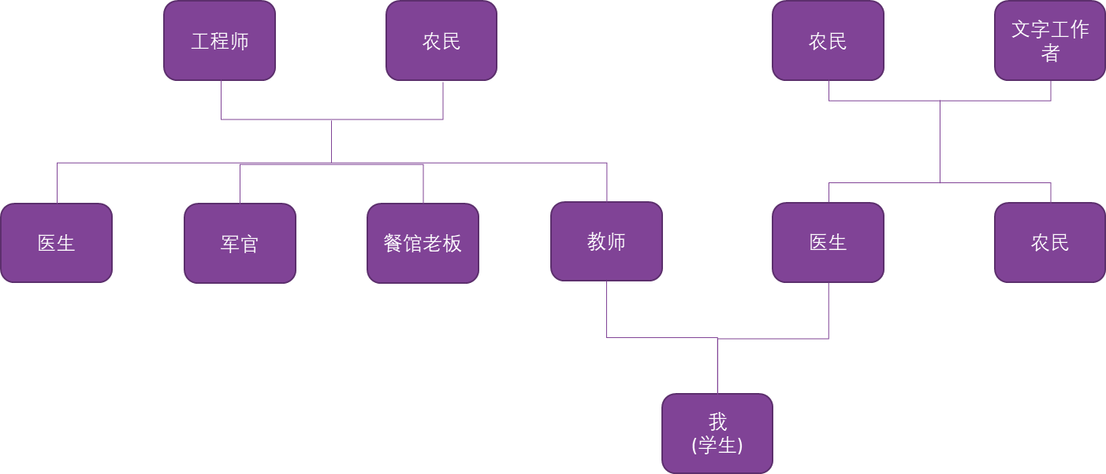

Slide 39

Hello!
I am Jane Doe
I am here because I love to design presentations.
You can contact me at @username

Slide 42
爷爷
(军人)
奶奶
(农民)
外公
(教师)
外婆
(教师)
姑姑
(职员)
爸爸
(商人)
妈妈
(医生)
阿姨
(公务员)
我
(学生)

